Slide 1
auxano
Business Group

Slide 2
HISTORY
Acquisition Strategy
Auxano Business Group is a diversified acquisition company, investing in buyouts of growth-oriented lower middle market companies.
Their goal is to build on their existing platforms in fluid power solutions, fabrication, hydraulic machinery, fluid handling pumps, and diesel engines.
Auxano’s objective is to provide its portfolio companies with financial, operational, and strategic guidance to create long-term shareholder value.
The partners of Auxano completed their first acquisition in 1994, with the purchase of Superior Diesel in Rhinelander, Wisconsin.
Since then, the original founders of Auxano, Mike Hucovski, Bernie Dahlin, and Bruce Wendt, went on to acquire nine other companies, all of which they still own.
Recent acquisitions have given them a national presence in the diesel engine business; however, their geographic focus remains in the Midwest.

Slide 3
Acquisition Process & Integration Approach
Auxano can quickly close transactions, because of its extensive experience in acquisitions, as well as, a very streamlined decision making process,
since the investment
decision is with the partners.
Auxano’s Principals are operating executives, so they understand how integral the existing management team is to the Company’s success.
They prefer not to change any of the ingredients which have created the successful business they wish to acquire.
The existing owner will find that Auxano understands the mechanics of running a successful company, and will bring significant value to the business, post-closing.

Slide 4
THE COMPANIES OF AUXANO
Multitek North America, LLC
Superior Diesel, Inc.
Bell Power Systems, LLC
Oil Air Products, LLC
Performance Fluid Power, LLC
Pump Systems, LLC
Wisconsin Metal Fabrication, LLC
Durable Controls, Inc.
G A Miller Company
Wood Beaver, Inc.

Slide 5
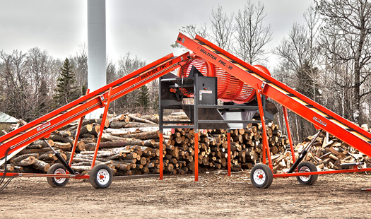
Manufacturers of Quality Hydraulic Driven Machinery for the Firewood, Scrap, and Mining Industries.
Concept Design / Engineering
Manufacturing / Field Service
MARKETS
Energy
Glycol & Air Heaters
Processors
New Product Development
www.multitekinc.com

Slide 6
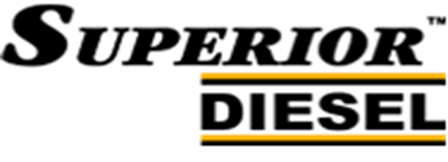
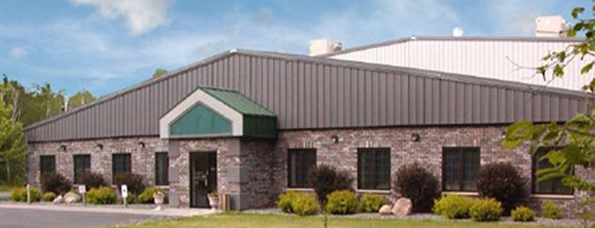
History & Locations
Superior Diesel was established in 1977 and is headquartered in Rhinelander, Wisconsin.
Our 49,000 square foot full-service facility is proudly placed in the beautiful Northwoods of Wisconsin.
Our second 39,000 square foot full-service facility is located in Seville, OH. Together we are able to provide premium customized value-added packages to the Midwestern United States.
www.sdiesel.com
Any Engine. Any Purpose. Endless Possibilities.
Superior Diesel is a leading Value-Added Distributor of John Deere Diesel engines and Funk Drivetrain components for the Midwestern United States.
We provide solutions for applications involving:
Generators
Water Pumps
OEM
Marine
Railway Maintenance
Forestry
& More!

Slide 7
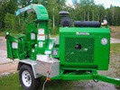
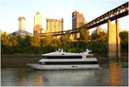
www.bellpower.com
FOUNDED IN 1967, as Bell Detroit Diesel, Bell Power systems has been one of the nation’s authorized distributors of John Deere diesel engines since 1989. Bell has also been a leading distributor of Yanmar Industrial diesel engines since 2005.
The sales territory covers the Eastern United States from Maine to Virginia, and as far West as New York and Pennsylvania. In 2012, Bell Power Systems became a part of the Superior Diesel family of companies.
Bell Power is located in Essex, Connecticut in a 60,000 square foot warehouse and manufacturing facility.
Bell Power develops and provides custom engineered packages to meet the needs of any application requiring reliable heavy duty power.
Bell Power offers engineering design assistance in all aspects of industrial and marine power applications.
Bell Power provides application testing of the final products under normal operating conditions in the field to ensure they operate within the manufacturer’s acceptance.
“OUR GOAL is to offer assistance to all our customers in applying current and future Tier engines properly, whether the need is working with your engineering staff or providing the engineering and design of the complete engine package.”

Slide 8
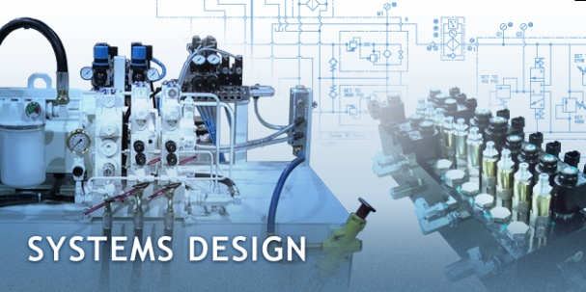
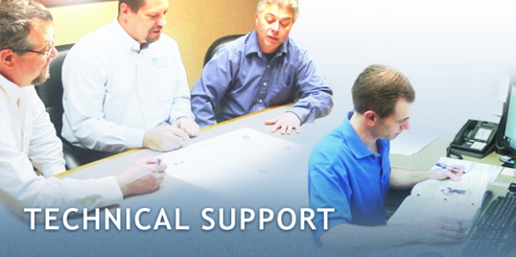
www.oilair.com
Since the inception of the company in 1983, Oil-Air Products has been focused on fluid power technical expertise and experience to provide leading edge, quality solutions to our customers.
Our Services include:
Complete system design and fabrication for the mobile and industrial markets.
Hose assembly fabrication
Fluid power component sales
Value added solutions
On site installation
Service and repair
Oil-Air Products provide the latest in fluid power technology and the experienced team is factory trained to integrate and support these products.
The mission is clear. Oil-Air partners with the customer to offer a unique, quality solution that gives them a competitive edge in their marketplace.
Oil-Air is located in Plymouth, MN. Expansion is underway on a 62,000 square foot facility.

Slide 9
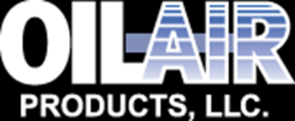
A Sampling of Oil-Air Products, LLC Partners

Slide 10
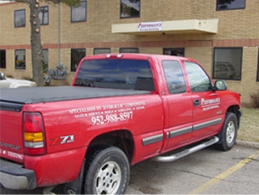
Service & Repair Equipment & Testing Emergency Services
Professional service and repairs delivered by factory-trained technicians.
Performance Fluid Power is a Sauer-Danfoss (Sundstrand) warranty and factory authorized service center.
Performance Fluid Power’s extensive testing capability gives our customers confidence that each unit will perform “like new” in the field. Performance Fluid Power also provides a one-year warranty covering parts and workmanship and offers customer-specific extended warranty programs.
Performance Fluid Power offers after-hours emergency service 24/7, providing a single point of contact and emergency assistance.
Performance Fluid Power is located in Minnetonka, MN
www.performancefluidpower.com

Slide 11
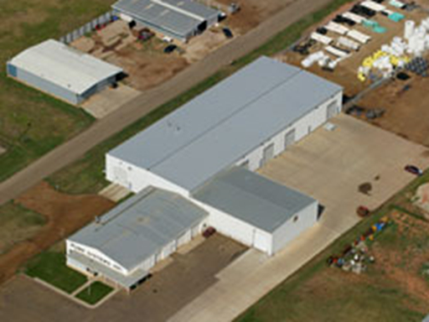
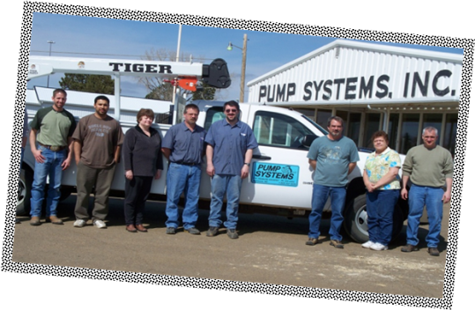
Pump Systems has been in business over 30 years, handling a wide variety of products to meet the needs of agricultural, residential, oilfield and industrial customers.
Located in Dickinson, ND*, in a 34,000 square foot building, Pump Systems has a full service repair shop with pump testing capabilities along with fabrication and machining equipment.
Pump Systems can design and build many items to assist with fluid handling needs , including designing and engineering water transfer systems, and can supply to customers, from inventory, a large variety of pumps, parts and accessories.
*An additional location is in Casper, WY
www.pumpsystems.com

Slide 12
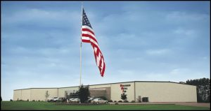
WISCONSIN METAL FAB
Capabilities:
Fabrication Services
Project Development
CNC Machining
Precision Laser Cutting
Plasma Cutting
Welding
CNC Shearing, Punching, & Forming
Sawing
Lifting
Inspection
Pre-finishing, Finishing, & Assembly
Transportation
WMF History
Wisconsin Metal Fab was founded in 1995, and moved to the present location in 2001.
In 2004 18,000 square feet were added.
But, as the Company size increased, so did the productivity. WMF quickly outgrew the 43,000 square feet, so, in 2006, they increased the size of the facility once again, to 70,000 square feet. In 2014 – a 7,000 square foot assembly, packaging and shipping area to help facilitate faster, more accurate order completion and pick-up.
A testament to continued growth, the 77,000 square-foot facility and more than 75 employees , triple what WMF started with in 2001!
Industries served:
Agriculture
Custom Truck Bodies
Defense
Mining
Oil & Gas
Power Generation
Railroad
Signage & Displays
Water Treatment
1875 Olson Drive Chippewa Falls, WI 54729

Slide 13
Durable Controls is a full-service stocking distributor of instrumentation & control products and industrial pneumatic & automation products for the OEM and user markets.
.
Actuators
Air Cylinders
Air Valves
Cellular-enabled Controllers
Custom Assemblies
Data Acquisition & Alarm Management
Enclosures
Industrial Computers & Operator Interface
Marquees & Electronic Signs
Mounting Systems
Rotary Actuators
Sensors
Slides, Thrusters & Grippers
Vacuum Components
Vibration Isolation
Wireless Communication
Durable Controls
Hartland, Wisconsin 53029

Slide 14
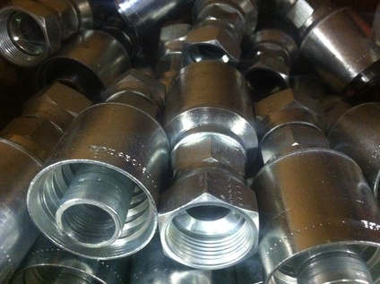
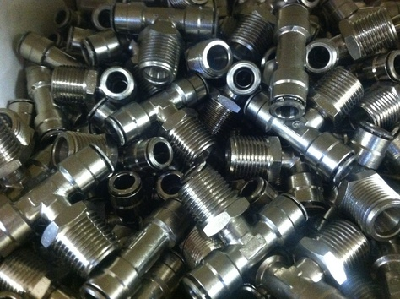
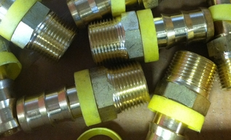
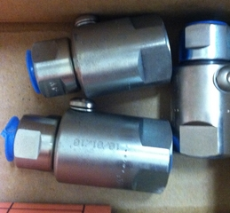
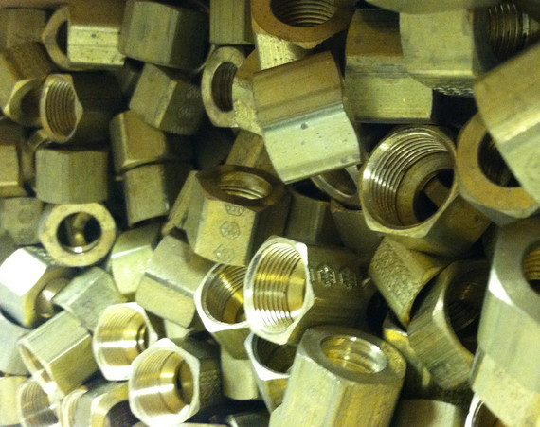
G.A. Miller Company is a full service hydraulic distributor, established in 1969, that offers a complete line of hydraulic products, including hydraulic hose, hose ends, brass fittings, connectors, black pipe, clamps, oil, in-line swivels, and much more.
“We make hose assemblies while you wait!”
Located in Prentice, Wisconsin

Slide 15
WOOD BEAVER, INC.
Firewood Processor
WOOD BEAVER is known throughout the United States and Canada for bringing our customers wood processing machinery that is affordable, versatile, and performance beyond our customer’s expectations.
WOOD BEAVER is proud to be “MVP”, the maximum value performance leader in the wood processing business.
https://www.woodbeaver.net/

Slide 16
DIVERSIFIED PACIFIC PARTNERS
Contact Information
Thomas A. Janicki
Cell: 949.315.9472 tjanicki@divpacpartners.com
Wisconsin Office
630 Main Street Delafield, WI 53018 262.244.7431

